Slide 1
Building an Infrastructure for Inquiry-Based Learning
Cory Laverty, Centre for Teaching and Learning
Jackie Druery, Head Humanities & Social Sciences Librarian,
Queen’s University

Slide 2
Where does inquiry fit at Queen’s?
Academic plan
Strategic research plan
External research review
Provost’s Advisory Committee on Teaching and Learning Working Group on Undergraduate Research

Slide 3
Inquiry initiatives at Queen’s
Inquiry Working Group:
Environmental scan across undergraduate courses
Interpretations of inquiry across disciplines
Study on supports needed (in progress)
Inquiry@Queen’s
Annual conference to celebrate inquiry-based learning that showcases research projects from Queen's undergraduates

Slide 4
Undergraduate Research Conference
Interdisciplinary conference 2007-present
Students share the results of their inquiry
Submit abstract for an oral presentation or poster
Themed sessions – same topic, different disciplinary perspectives
One keynote session with faculty guest speaker and students
Poster session – with pizza!
Held in Queen’s Learning Commons in the library

Slide 5
What is inquiry-based learning?
Activity
How do you define inquiry-based learning?
List some words and phrases that describe inquiry-based learning
Group similar features

Slide 6
What is inquiry?
Inquiry requires more than simply answering questions or getting a right answer. It espouses investigation, exploration, search, quest, research pursuit and study. (Kuhlthau, 2007)
Queen's definition: "a dynamic, iterative, and developmental process where students engage in asking and researching questions of interest."

Slide 7
Inquiry & Undergraduate Research
Engage in asking and researching questions of interest
(new to them or even the discipline)
Iterative process: finding, evaluating, organizing, analyzing, and disseminating information
Developmental building of concepts and skills across a program
Independent or group work
Dissemination of results come in many formats (e.g., essay, poster, blog, presentation)
Across the disciplines

Slide 8
How does inquiry support learning?
Positive impacts on student personal, academic, and professional development (Healey & Jenkins, 2009; Kuh 2009; Levy & Petrulis, 2012)
Many undergraduates feel they learn best when completing their own research projects (Turner et al., 2008)
Promotes “critical thinking, problem solving, taking responsibility for one’s own learning, and the desire for lifelong learning” (Lee, 2011)
Positive impact on learning involvement and academic peformance (Zafra-Gómez et al., 2015)
Large-scale studies demonstrate significant learning gains and benefits to disadvantaged students (Hmelo-Silver et al., 2007)

Slide 9
Student Perspectives on Inquiry: Our Study
How valuable do you think your undergraduate research/inquiry experience has been to your own self-development and interests? 61% - very valuable/valuable; 26% somewhat valuable; 16% not valuable
Do you feel you learned skills that were valuable for other courses or projects? 65% identifying sources; 68% collecting data and useful information; 70% analyzing data/information; 68% organizing/managing sources and ideas; 57% evaluation of sources

Slide 10
Student perspectives on inquiry
Major themes reported:
Better prepared to work with a team
Taught me about myself, self-reflection, what I'm interested in
Valuable skills important to employers – research, information skills, presentation skills, confidence, critical thinking skills
Learn how to find, analyze, evaluate information
Learn how to develop new ideas, support those ideas, think outside the box

Slide 11
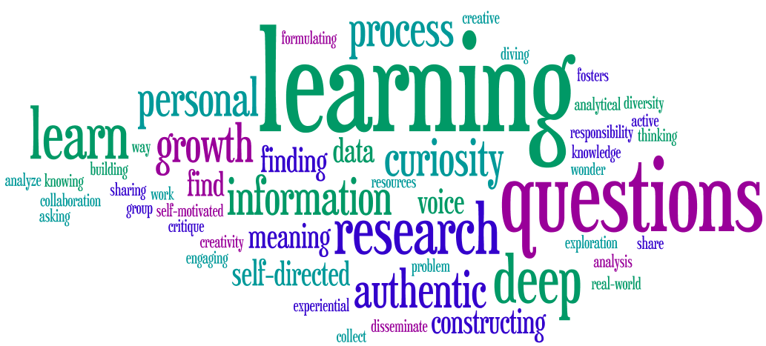
Faculty perspectives on inquiry

Slide 12
Librarian Feedback from OLA Session 2017

Slide 13
Reframing Information Literacy
Activity:
If you were to reframe your information literacy program around the concept of inquiry-based learning:
How would this change what you’re doing now?
What challenges and benefits do you predict or have you experienced?

Slide 14
Inquiry as a Transformative Frame
Language more familiar to faculty | Viewed as a teaching approach
Crosses disciplines | Faculty are central to the process
Relates to threshold concepts | Seen as developmental
Aligns with institutional strategies | In faculty research literature
Valued by students | Linked to best teaching practices
Encompasses information literacy | Fosters inclusive classroom
Connects to K-12 | Process is assessed
Holistic process | Can promote academic integrity

Slide 15
Using a Logic Model for Planning

Slide 16
Purpose and Needs Assessment
Purpose:
To enable undergraduate students to become competent in conducting inquiry and research projects over the duration of their program.
Needs assessment:
Literature review
Document analysis of university strategic priorities and plans
Environmental scan of courses using inquiry in undergraduate programs
Survey on student perspectives and needs related to inquiry

Slide 17
Resources
Librarians!
Research guides and information resources for students
Professional development materials for instructors (such as examples of different types of inquiry assignments and assessment methods across disciplines)

Slide 18
Activities
What needs to be done to deliver a program?
Perform a comprehensive inquiry assessment
Define inquiry at institutional level
Map existing inquiry pathways across programs
Share findings and receive feedback from departments
Share findings and receive feedback from student groups
Develop faculty learning series on inquiry-based learning
Strategize on a developmental approach to scaffolded inquiry across different programs

Slide 19
Conceptual frameworks
What shapes the model? What makes it work?
Constructivism:
Construction of personal understanding through experience (Piaget, Vygotsky, Bruner, Gardner, Bereiter, Scardamalia)
Cognitive apprenticeship:
Process by which learners learn from a more experienced person by way of cognitive and metacognitive skills and processes. Includes modeling coaching, scaffolding, reflection, exploration. (Collins, Brown, & Newman)

Slide 20
Outputs
What products can be easily measured as a result of the program?
NOTE: These don’t describe quality.
I@Q Undergraduate Research Conference participation
Faculty and Teaching Assistant attendance at inquiry workshops
Number of courses with an inquiry component
Number of students completing an independent study
Adoption of standard definition of inquiry in strategic documents
Map of inquiry pathways on departmental and career websites
Creation of clusters of generic undergraduate research skill courses

Slide 21
Examples of Outcomes
Outcomes measure a change and are indicators of quality.
Short:
Departments identify pathways for inquiry within programs
Medium:
Models for developing inquiry articulated in academic departments
Faculty include inquiry skills for development in assignments and syllabi
Long term:
Student inquiry and research competencies increase
A researcher skills framework is adopted across the campus
Students describe inquiry skills they have learned on their CV

Slide 22
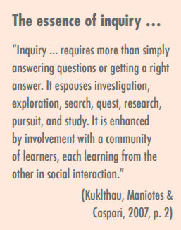
Inquiry: Ontario Model K-12
From Inquiry-based Learning. (2013). Capacity-Building Series. Student Achievement Division to support leadership and instructional effectiveness in Ontario schools.

Slide 23
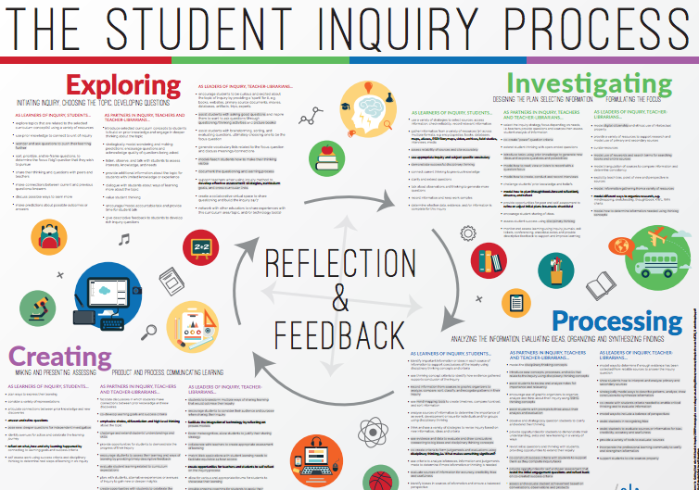

Slide 24
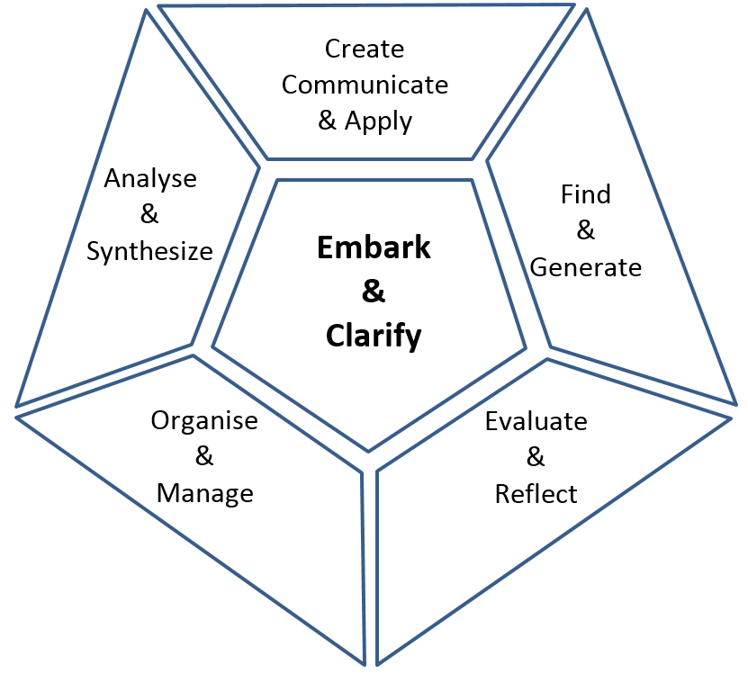
Inquiry model that extends across post-secondary
Facets of Research from:
Willison, J. & O’Regan, K. (2015). Researcher skill development framework.
www rsd.edu.au

Slide 25
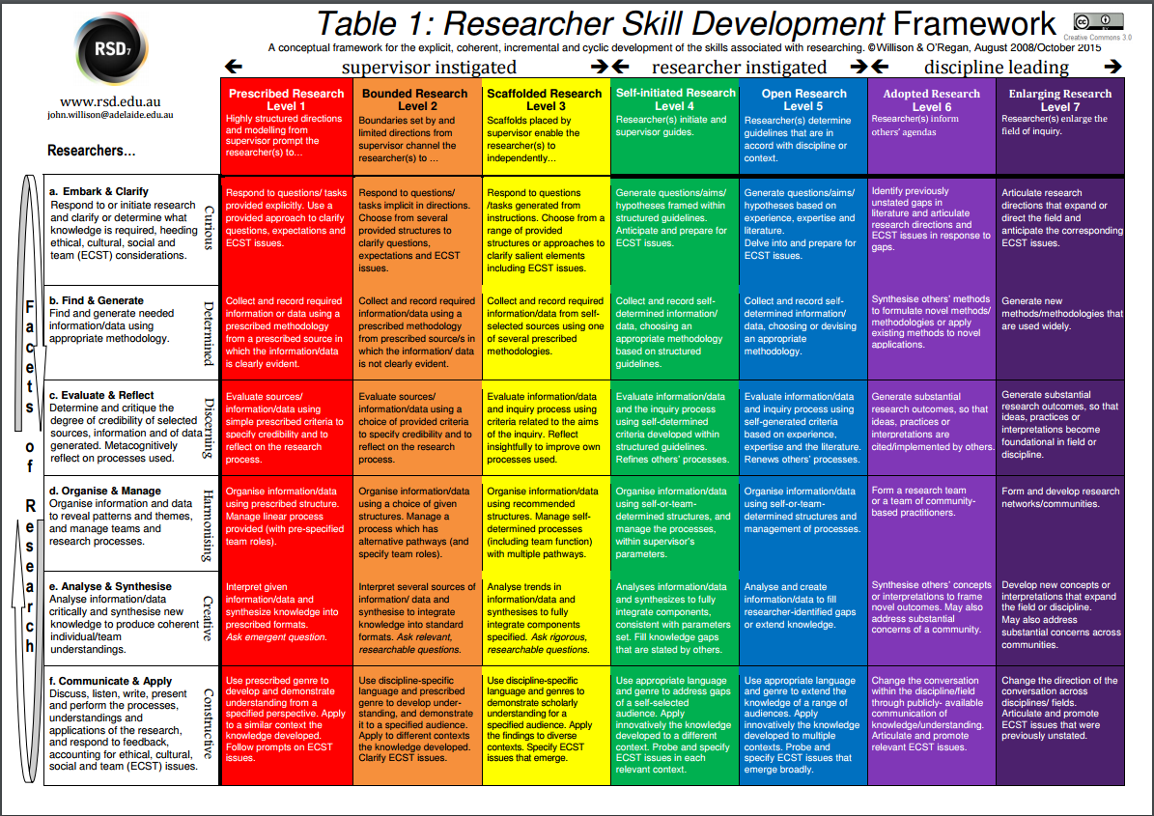
Willison, J. & O’Regan, K. (2015). Researcher skill development framework. www rsd.edu.au

Slide 26
References
Collins, A., Brown, J. S., & Holum, A. (1991). Cognitive apprenticeship: Making thinking visible. American Educator, 15(3), 6-11.
Cooperstein, S. E., & Kocevar-Weidinger, E. (2004). Beyond active learning: a constructivist approach to learning. Reference Services Review, 32(2), 141-148.
Dennen, V. P., & Burner, K. J. (2007). The cognitive apprenticeship model in educational practice. Handbook of research on educational communications and technology, 425–439. New York: Springer.
Healey, M., & A. Jenkins. (2009). Developing undergraduate research and inquiry. York, UK: Higher Education Academy.
Hmelo-Silver, C. E., Duncan, R. G., & Chinn, C. A. (2007). Scaffolding and achievement in problem-based and inquiry learning: A response to Kirschner, Sweller, and Clark (2006). Educational psychologist, 42(2), 99-107.
Inquiry-based Learning. (2013). Capacity-Building Series. Student Achievement Division to support leadership and instructional effectiveness in Ontario schools.
Kuh, G.D. (2009) High impact activities: what they are, why they work, who benefits. In: Rust, C. (ed.) Improving student learning through the curriculum. Oxford: Oxford Centre for Staff and Learning Development, Oxford Brookes University.
Kuklthau, C.C., Maniotes, L.K. & Caspari, A.K. (2007). Guided inquiry: Learning in the 21st century. Westport, CT: Libraries Unlimited.
Lee, V. S. (2011). The power of inquiry as a way of learning. Innovative Higher Education, 36(3), 149-160.
Levy, P., & Petrulis, R. (2012). How do first-year university students experience inquiry and research, and what are the implications for the practice of inquiry-based learning?. Studies in Higher Education, 37(1), 85-101.
Turner, N., Wuetherick, B., & Healey, M. (2008). International perspectives on student awareness, experiences and perceptions of research: Implications for academic developers in implementing research-based teaching and learning. International Journal for Academic Development 13(3), 199–211.
Zafra-Gómez, J. L., Román-Martínez, I., & Gómez-Miranda, M. E. (2015). Measuring the impact of inquiry-based learning on outcomes and student satisfaction. Assessment & Evaluation in Higher Education, 40(8), 1050-1069.

Slide 27
Acknowledgements
Ramna Safeer, 3rd year undergraduate student, Research Assistant
Victoria Remenda, Associate Dean, Teaching & Learning, Chair of the Queen’s Inquiry Working Group
Contact Us:
Jackie Druery: Jackie.Druery@queensu.ca
Cory Laverty: lavertyc@queensu.ca

